Slide 1
Understanding Recent Results from the National Ignition Facility
John P. Holdren
Prepared initially 21 October 2013 Slide 14 addresses new test result of 8 August 2021

Slide 2
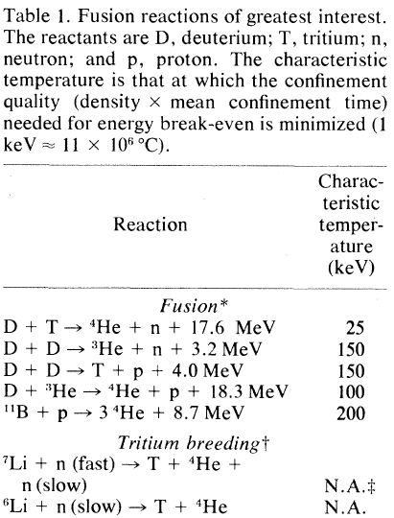
Fusion reactions require extraordinary combinations of temperature and pressure.
At pressures manageable on Earth, even the most reactive fusion fuels ignite only at temperatures in excess of 100 million degrees C.
The fusion fire that powers the Sun burns at somewhat lower temperatures, because the huge mass of the Sun creates enormous pressures via its gravitational force.
From J. P. Holdren, SCIENCE, December 1978

Slide 3
Harnessing fusion requires maintaining the needed combination of fuel temperature and pressure for long enough to yield energy exceeding what was invested in creating the temperature and pressure in the first place, before the fuel escapes.
The Sun achieves this by “gravitational confinement”, which doesn’t work on Earth because the entire mass of the planet is insufficient (else we’d be a star).
The only two ways to harness fusion energy on Earth are:
inertial confinement, in which a large amount of energy is transferred instantaneously to the fuel by intense electro-magnetic radiation or energetic particles, whereupon fusion ensues until the fuel blows itself apart; and
magnetic confinement, in which powerful, carefully shaped magnetic fields are able to hold the fuel together while it burns (because at the needed temperature the fuel is ionized and thus responds to magnetic fields).

Slide 4
The hydrogen bomb works via inertial confinement.
In that case, the source of the energy used for heating and compressing the fusion fuel is a fission bomb (“primary”).
After energy transferred from the primary ignites the fusion fuel in the “secondary”, only inertia holds that fuel together for long enough to yield a big energy multiplier.
Inertial confinement using nuclear bombs is unattractive for meeting civilization’s energy needs, for many reasons.
The alternative of inertial confinement fusion using energy from lasers or ion beams to compress and heat the fusion fuel is being used for three purposes:
studying the physics of nuclear weapons without exploding actual bombs;
studying the properties of matter under extreme conditions;
pursuing the possibility of using inertial-confinement fusion as a practical source of heat and electricity for society.

Slide 5
The National Ignition Facility (NIF) at the Lawrence Livermore National Laboratory is the most advanced (and expensive) facility in the world for the pursuit of these three purposes.
Begun in 1997 and completed in 2009, it cost $3.5 billion in government funds to build.
Its primary justification from the outset was the weapon-physics mission, and nearly all of its cost was supported from the budget of the National Nuclear Security Administration.
Developing the science and technology that could make inertial-confinement fusion a practical energy source has always been a secondary mission, but it has greater appeal than the weapons-science mission to many members of the public and some members of Congress.
NIF has yielded benefits in weapons science and in under-standing inertial-confinement fusion-energy prospects, as well as in fundamental science, while still short of its “ignition” goal.

Slide 6
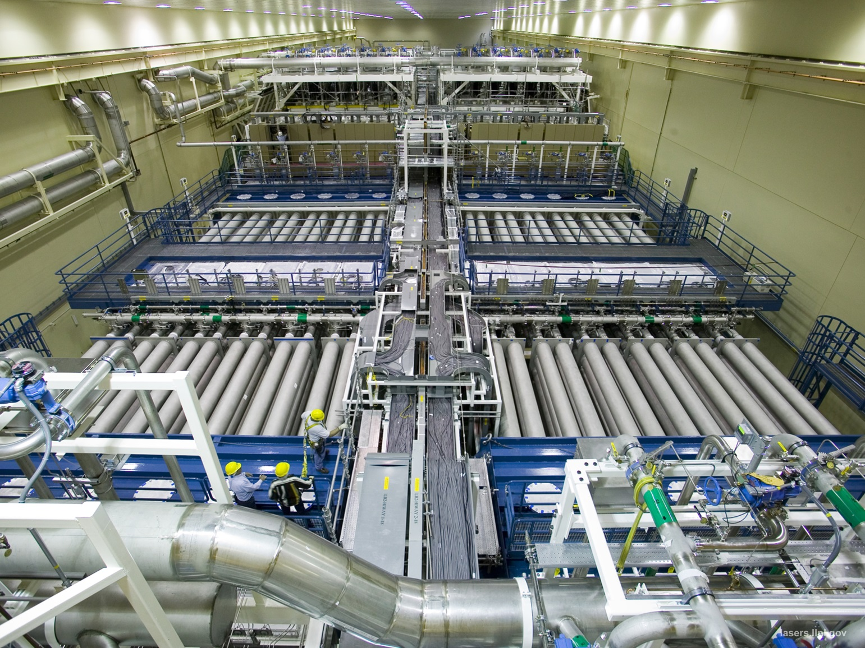
The NIF covers an area equal to three football fields. Its laser bay (shown) houses 192 beamlines that together deliver a 1.8 megajoule pulse of ultraviolet light (wavelength 351 nanometers) to the target chamber. The neodymium-doped phosphate-glass laser is the most powerful laser in the world.

Slide 7
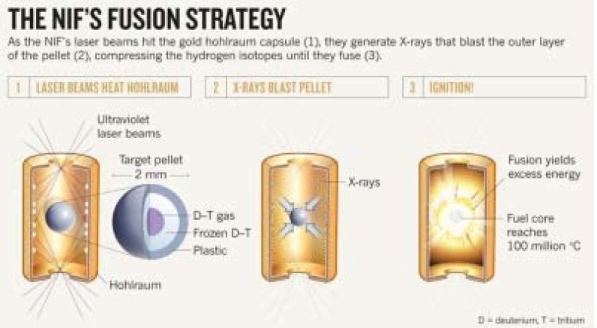
NIF is currently being operated in an “indirect drive” mode. This means that the laser energy is not deposited directly on the fusion-fuel pellet but rather on the inner surface of a gold-lined “hohlraum”. Upon absorbing the UV light, the gold emits a burst of X-rays. These impinge symmetrically on the target pellet in the center of the hohlraum.
The plastic surface layer on the target pellet serves as an “ablator”: the sudden absorption of energy from the X-rays causes it to expand outward at high velocity, to which the equal and opposite reaction is an inward-propagating shock wave that compresses the fuel to 100 times the density of lead.

Slide 8
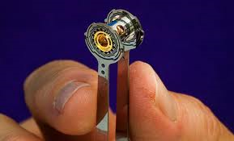
The hohlraum is tiny (10 mm length, 5 mm diameter) but complex and manufactured to extreme precision. It must include cryogenic cooling for the 2 mm fuel pellet within, whose frozen deuterium and tritium must be kept at 18 kelvin (minus 255 degrees C).
In this photo, the appendages by which the hohlraum is being held are the cryogenic-cooling leads.

Slide 9
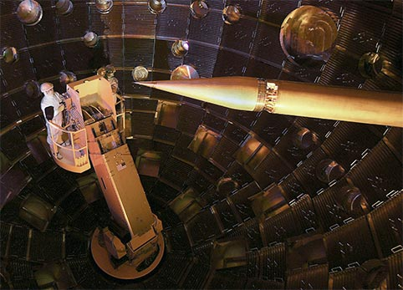
The hohlraum must be positioned with extraordinary precision at the point within the target chamber where the laser beams converge.
This photo shows the scale of the target chamber and the positioner, which is the pointed cone at the upper center.

Slide 10
In the shots conducted in the NIF to date, only a small “hotspot” at the center of the fuel pellet undergoes fusion reactions; most of the fuel does not react. Criteria used to measure progress toward better performance include the following:
“alpha heating” is attained when alpha particles (helium nuclei) resulting from fusion reactions supply twice as much energy to the fuel as it absorbs from the X-rays;
“ignition” is achieved when heating by alpha particles propa-gates the fusion reactions outward from the hotspot to the extent that most of the fusion fuel in the pellet reacts;
“energy break-even” is defined in multiple ways, including as (a) when the fusion energy released exceeds the X-ray energy that reaches the fuel (a lower bar than “alpha heating”) or (b) when it exceeds the energy delivered by the laser to the reaction chamber (a higher bar than “ignition”) or (c) when it exceeds the energy supplied to the laser (a much higher bar still).

Slide 11
A practical reactor would need to achieve performance far exceeding the most ambitious of the above definitions of energy break-even.
That is because the reactor output needs not only to power the laser but also to have something well in excess of the laser’s requirements left over to deliver to the grid, and because the efficiency of conversion of fusion energy (carried by neutrons and alpha particles) to electrical energy is unlikely to exceed 50 percent.
Practicality in a reactor is a matter not just of advantageous energetics per shot; to sustain an output electrical power equivalent to that of a modern nuclear-fission power plant, a practical inertial-confinement fusion reactor would need to sustain a firing rate in the range of 10-20 shots per second. The current NIF can manage at most 2 shots per day.

Slide 12
The then record-high-energy NIF shot reported, to much fanfare, in September 2013, achieved “energy break-even” only under the least stringent definition. Here are the numbers, per shot:
electrical energy supplied to the capacitor bank that drives the laser = 420 megajoules (electrical; thermal equivalent is higher)
ultraviolet laser energy delivered to the target chamber
= 1.8 megajoules
X-ray energy produced in the hohlraum
= 1.2 megajoules
X-ray energy absorbed by the ablator on the fuel capsule
= 0.150 megajoules
energy delivered to the fusion fuel
= 0.012 megajoules
fusion energy produced = 0.014 megajoules (thermal)

Slide 13
Fusion energy yield exceeding energy supplied to the fuel is indeed a milestone, but a modest one, representing achievement of the least demanding of all of the relevant thresholds.
The performance fell somewhat short of meeting the “alpha heating” threshold, far short of meeting the “ignition” threshold, and even farther short of meeting the stronger “energy breakeven” threshold.
For NIF conditions, ignition would be indicated by a fusion energy yield of about 1 megajoule. The yield from the late-September shot was about 70 times smaller than this (1 MJ / 0.014 MJ = 71.4).
It was about 130 times smaller than the laser energy reaching the target chamber (1.8 MJ / 0.014 MJ = 128.6) and about 30,000 times smaller than the electrical energy supplied to the laser (420 MJ / 0.014 MJ = 30,000).

Slide 14
UPDATE: The more stringent “ignition” condition was met by NIF in a shot of 8 August 2021. Here are key numbers for that shot:
electrical energy supplied to the capacitor bank that drives the laser = 400 megajoules (electrical; thermal equivalent as high as 1200 MJ)
ultraviolet laser energy delivered to the target chamber
= 1.9 megajoules
X-ray energy delivered to the ablator on the fuel capsule
= 0.230 megajoules
energy delivered to the fusion fuel
= 0.02 megajoules
fusion energy produced = 1.3 megajoules (thermal)
size of net energy shortfall = 400-1200 MJ/1.3 MJ ≈ 300-1000
additional shortfalls with respect to commercial feasibility:
repetition rate ≈ 400,000; cost of pellet ≈ 500,000

Slide 15
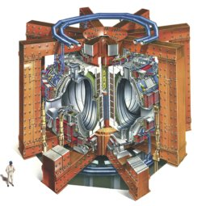
The alternative to inertial confinement for harnessing fusion on Earth–magnetic confinement–is closer to meaningful energy break-even.
In 1997, the Joint European Torus (JET) achieved a peak fusion output of 16 megawatts from 24 megawatts of input power to the fuel and 500 megawatts powering the device.
The fusion energy yield per pulse was about 35 MJ, which is 2500 times larger than the 0.014 MJ achieved by NIF in 2013.
Fusion output was 30x smaller than the electrical input to the device (compare 30,000x smaller for NIF).
The next-generation magnetic-fusion device, ITER, is projected to deliver 500 megawatts of fusion power from 50 megawatts of input power to the fuel.

Slide 16
Federal budgets for magnetic-fusion energy (MFE) and inertial-confinement fusion (ICF), millions of current dollars
FY2012 FY2014
enacted request
ICF from NNSA 475 514
ICF from Fusion Energy Sciences 25 7
of which NIF 291 349
MFE from Fusion Energy Sciences 401 458
of which ITER 105 225
The contribution to ICF from the Fusion Energy Sciences (FES) Division in DOE’s Office of Science shrinks in the FY2014 request because of the judgment that MFE is a better long-run bet to achieve practicality as an energy source, reinforced by a desire to protect domestic research in MFE as the rising cost of ITER eats into the FES budget.

